Slide 1
Keagan Erasmus
Agora E-commerce Site

Slide 2
Section A

Slide 3
Technical Features

Slide 4
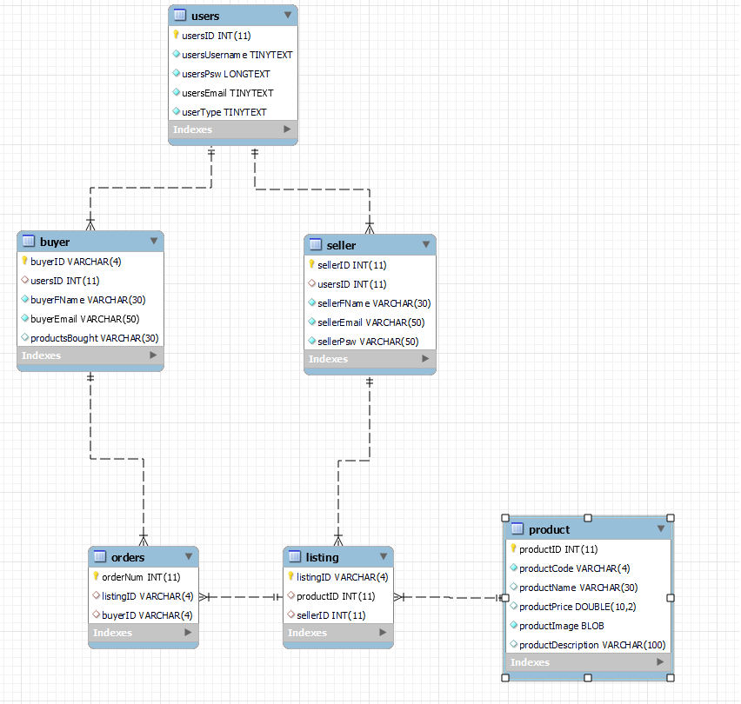
Database Tables

Slide 5
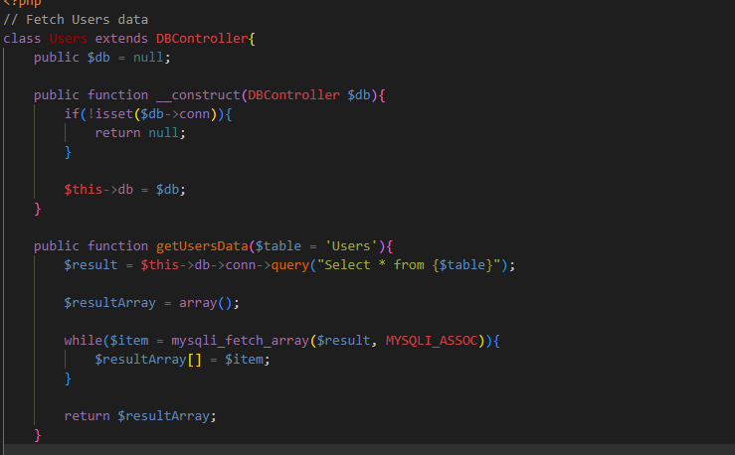
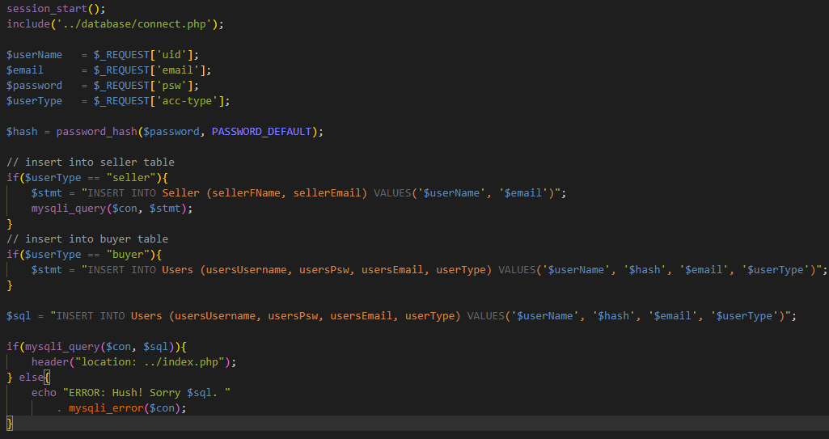
Gets Data and inserts Data Simple Select and display query

Slide 6
Section B - Solid

Slide 7
Single-responsibility principle

Slide 8
Open-closed principle

Slide 9
Liskov substitution principle

Slide 10
Interface segregation principle

Slide 11
Dependency Inversion Principle

Slide 12
Lessons learned

